Slide 1

Student Performance Analysis
Analyzing academic performance across Math, Reading, and Writing to identify key factors influencing student achievement and success rates.
Created by —
Harshit Verma

Slide 2

Project Overview
Purpose
Approach
Analyze student academic performance across three major subjects and identify key factors influencing overall achievement using data-driven insights.
Python-based EDA, SQL analytics, and a multi-page Power BI dashboard provide comprehensive insights on demographics, behavior, and subject-level performance.

Slide 3



Dataset Overview
1,000 Students
3 Core Subjects
Multiple Metrics
Comprehensive records across demographic, academic, and behavioral attributes
Math, Reading, and Writing scores with pass/fail indicators
Total score, average score, performance bands, and grade classifications
Demographics
Academic Data
Behavioral
Gender
Subject Scores
Test Preparation
Race/Ethnicity
Performance Bands
Course Completion
Parental Education
Grade Bands (A-F)
Lunch Type
Pass Indicators

Slide 4
Technology Stack
Python
SQL
Power BI
Pandas and NumPy for data cleaning. Seaborn and Matplotlib for EDA visualization and correlation analysis.
Advanced queries with window functions, ranking, segmentation, and demographic comparisons for deep insights.
3-page interactive dashboard with custom DAX measures, KPI cards, and dynamic visualizations.

Slide 5




Methodology
Data Cleaning
EDA Analysis
Removed inconsistencies, verified data types, created derived features including total score, pass flags, and performance bands.
Subject score comparisons, correlation heatmaps, pass-rate analysis, and performance segmentation with comprehensive visualizations.
SQL Queries
Dashboard Build
Identified struggling subjects, calculated pass rates by demographics, ranked performers, and analyzed demographic effects.
Created interactive 3-page dashboard covering overview, subject analysis, and demographic impact with dynamic filters.

Slide 6

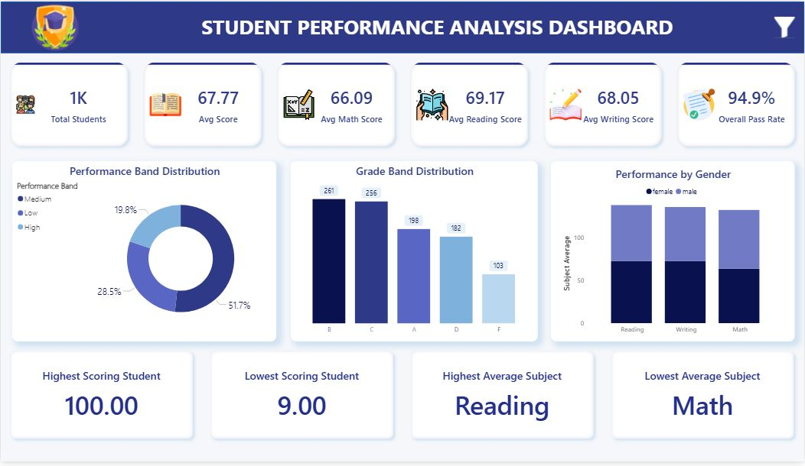
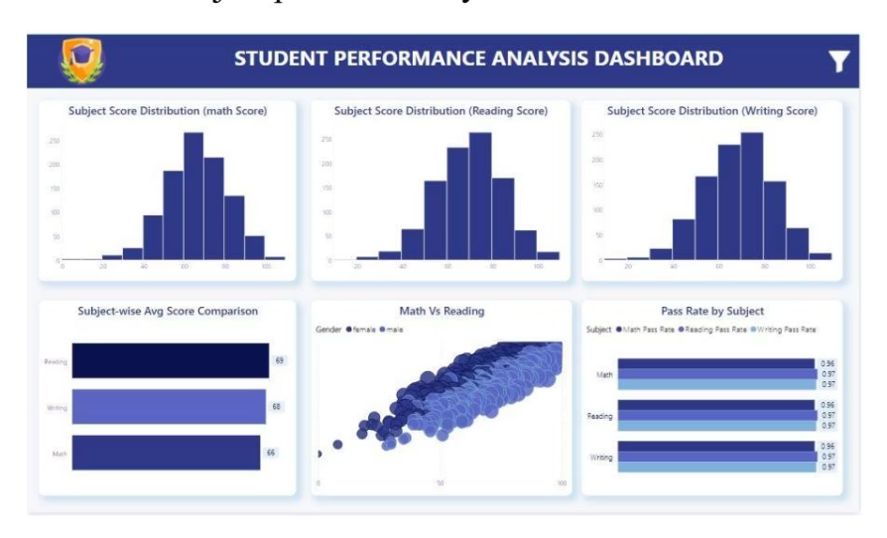
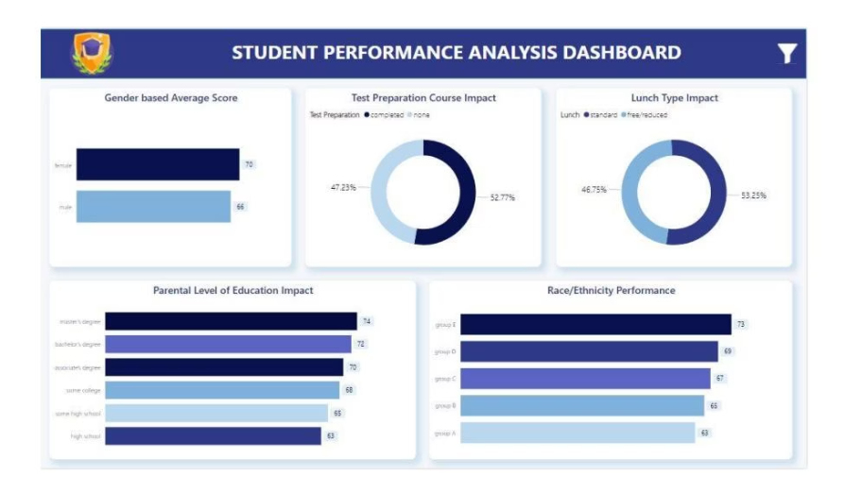
Power BI Dashboard
Page 1: Overview Dashboard
Page 2: Subject Analysis
Page 3: Demographics

Slide 7

Key Insights
1
Math is Most Challenging
Math shows the lowest pass rates and highest variability. Reading and Writing have stronger averages and high positive correlation.
2
Socioeconomic Impact
Standard lunch students outperform free/reduced lunch students by 10+ points. Parental education significantly influences scores.
3
Gender Differences
Females outperform males in Reading and Writing, while Math scores remain relatively balanced across genders.
4
Test Prep Works
Students completing test preparation courses score 12-15 points higher on average with far higher pass rates across all subjects.

Slide 8

Performance Breakdown
10+
12-15
85+
Point Gap
Test Prep Boost
High Performers
Standard lunch students outperform free/reduced lunch students
Average point increase for students who completed preparation courses
Average score threshold for top-performing student cluster
Subject Correlation
Reading and Writing show strong positive correlation, indicating students strong in one tend to excel in the other. Math varies more independently.

Slide 9
Recommendations
01
02
03
Strengthen Math Support
Promote Test Prep
Support Low-Income Students
Provide additional tutoring, early intervention for low performers, and encourage participation in prep courses.
Make preparation courses mandatory for struggling students given their demonstrated significant impact on performance.
Introduce mentorship, academic support, and learning resources for free/reduced lunch students who score lower.
04
05
Engage Parents
Leverage Reading & Writing
Conduct workshops to involve low-education households, as higher parental education correlates with student success.
Focus on these correlated subjects to lift overall performance through targeted improvements.

Slide 10

Conclusion
This project successfully demonstrates how data analytics can transform education by combining Python EDA, SQL analytics, and Power BI dashboards to uncover hidden patterns in student performance.
The insights obtained help educators, policymakers, and institutions design more effective interventions, improve academic outcomes, and provide targeted support where students need it most.
"Data-driven insights enable us to move from intuition to evidence-based strategies that truly impact student success."

